Slide 1
CHAPTER THREE
BUSINESS FORMATION

Slide 2
INTRODUCTION
A business formation deals with the formalization and actual implementation of business ideas in to practice.

Slide 3
3.2 The Concept of Small Business Development
Based on socio-economic conditions, countries define small business differently.
But all may use size and economic criteria as a base to define small business.
Size: Include number of employees and startup capital and doesn’t always reflect the true nature of an enterprise as qualitative characteristics also used to differentiate small business from other business.
The economic/control covers market share, independence and personalized management.

Slide 4
Con’t…
Micro and small enterprises (MSEs) play an important role in both developed and developing economies.
Ethiopia is no exception and MSEs could occupy a prominent position in the development of the Ethiopian economy.
Less capital, enjoy quick returns and have the flexibility to handle the vagaries (change) of the market.
, they have to face many problems like lack of finance, poor operations management, lack of experience, poor financial management, etc,.

Slide 5
3.3 Forms of Business organizations
There are three basic legal forms of businesses.
Proprietorship
Partnership and
Corporation

Slide 6
Description of Legal Forms of Business
The legal forms are classified based on
Ownership
Liability
Start-up costs
Continuity
Transferability of interest
Capital requirements
Management control
Distribution of profits or losses
Attractiveness for raising capital.

Slide 7
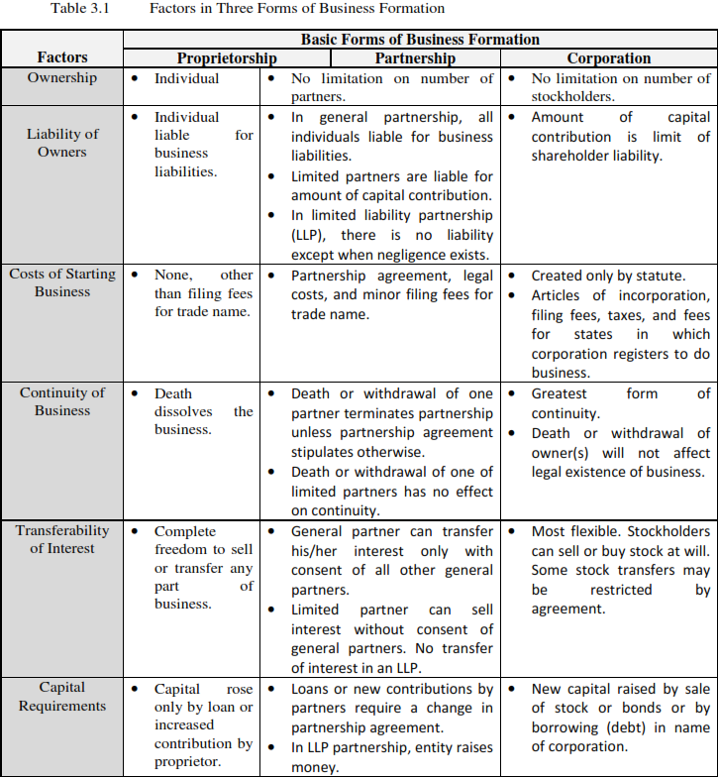

Slide 8
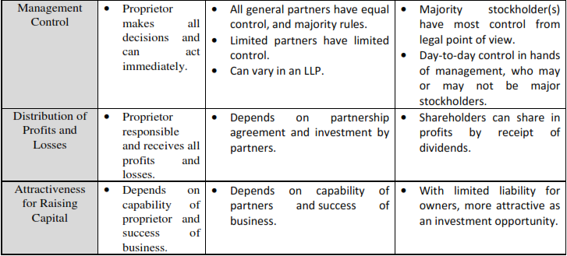

Slide 9
3.4 Definition and Role/Importance of SMEs in Developing Countries
3.4.1 Definition of MSEs
Size Criteria approaches
Though the criteria used to measure the size (scale of operation) of businesses vary.
The most widely used yardsticks are;
The number of employees
Volume, and value of sales turnover
Asset size, and volume of deposits
Total capital investment
Volume/value of production, and
A combination of the stated factors

Slide 10
Con’t…
The general criteria are suggested by Small Business Administration (SBA).
Owned and financed by one individual or a small group/ 15 or 20 owners in a rare case/.
The firm’s operations are geographically localized.
The business is small Compared to the biggest firms in the industry
The number of employees in the business is usually fewer than 100.

Slide 11
2. Economic/control criteria approach.
Covers four characteristics :
Small market share: it is not large enough and unable to influence the prices of national quantities of goods sold to any significant extent.
Independence: ,the owner control the business himself/herself.
Personalized Management: little delegation/ the owner actively participates in all aspects of the management of the business
Limited geographical area of operation; The operation of a small firm is often local.

Slide 12
3.4.2 Role/Importance of MSEs in Developing Countries (Reading Assignment)
Large Employment Opportunities:
Balanced Regional Development/ Removing Regional Imbalance
Equitable Distribution of Wealth and Decentralization of Economic Power
Unregulated Growth of Large-scale industries
Dispersal over Wide Areas
Higher Standard of Living
Mobilization of Locals Resources/Symbols of National Identity

Slide 13
Con’t…
Innovative and Productive /Simple Technology
Less Dependence on Foreign Capital/ Export Promotion
Promotion of Self Employment
Protection of Environment
Shorter Gestation Period
Facilitate Development of Large Scale Enterprises
Individual Tastes, Fashions, and Personalized Services
More Employment Creation Capacity

Slide 14
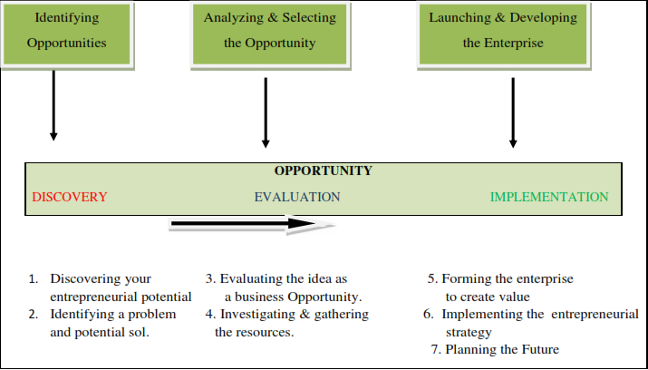
3.5 Setting up Small Scale Business
The entrepreneurial process of launching a new venture can be divided into three key stages of: Discovery; Evaluation; and Implementation. These can be further sub-divided into seven steps as shown below:

Slide 15
Environmental Analysis
For an analysis of the environment of entrepreneurship you would be required to develop an understanding of macroeconomic and industry/sector specific factors.
Macro Environment
Consists of the political, technological, social, legal and economic environments.
Sectoral Analysis
Study the sector or industry conditions in which the entrepreneur proposes to launch a venture.

Slide 16
SWOT Analysis
A SWOT analysis helps the entrepreneur to clearly identify his/her own strengths and weaknesses as well as the opportunities and threats in the environment.

Slide 17
con’t…
Macro
Environmental Analysis
Sectoral Analysis
SWOT Analysis
Product/Service
Fig 3.2 Hierarchical Environmental Analysis

Slide 18
3.6 Small Business Failure and Success Factors
3.6.1 Small Business Failure Factors
What Is Business Failure?
Actions such as bankruptcy, foreclosure, or voluntary withdrawal from the business with a financial loss to a creditor or
A Court action such as receivership (taken over involuntarily) or reorganization (receiving protection from creditors).

Slide 19
Causes of Business Failure
The most common causes are inadequate management and financing.
Inadequate Management;
89 % of failure of the businesses is internal factors (controllable factors)
Adequate capital
Cash flow
Facilities/equipment
Inventory control
Human resources
Leadership
Organizational structure
Accounting systems

Slide 20
Inadequate Financing:
Includes improper managerial control as well as shortage of capital.
You don’t have adequate funds to begin with, you will not be able to afford the facilities or personnel you need to start up the business correctly.
You do possess adequate capital but do not manage your resources wisely, you may be unable to maintain adequate inventory or keep the balance needed to run the business.

Slide 21
Con’t…
In General, There are various causes of failure ;
Extend too
Much credit
Fail to plan for the future
Overinvest in fixed assets
Hire the wrong people.

Slide 22
Business Termination VS Failure
A termination occurs when a business no longer exists for reasons of getting opportunity to sell for a profit, to move on to a new business , to retire, or lost interest in the business.
If market for product have changed or become saturated, owner decided it would be more appealing to work for someone else.
A business failure occurs when a business closes with a financial loss to a creditor.

Slide 23
Mistakes Leading to Business Failure
The most common mistakes are;
Neglect to plan for the future
Lack of commitment and hard work
No delegation/ not hiring additional employees
Inaccurate estimates of cash flow and capital requirements.

Slide 24
3.6.2 Small Business Success Factors
Identifying failure factors can discover ways to tilt the scales towards success. These success factors are categorized as:-
Conducive Environment;
Adequate Credit Assistance;
Markets and Marketing Support.
Conducive Environment
Political, economic, technological and socio-cultural factors

Slide 25
Adequate Credit Assistance
Adequate and timely supply of credit
Special financing programs such as lower interest rates; less collateral requirements and lower equity ratio;
Various assistance schemes such as preparing the project study; etc.
Markets and Marketing Support
Small enterprises can sell their products as one body through closely-knit associations or organizations.
The government assist small groups of entrepreneurs in selling their products.

Slide 26
Table 3.2. Improved definition of MSE
Level of Enterprise | Sector | Human Power | Total Asset
Micro Enterprise | Industry | ≤5 | Br ≤100,000
 | Service | ≤5 | Br ≤50,000
Small Enterprise | Industry | 6-30 | Br ≤1,500,000
 | Service | 6-30 | Br ≤500,000

Slide 27
Priority Sectors and Sub-Sectors for MSEs Engagement In Ethiopia
Manufacturing Sector
Construction Sectors
Trade Sectors
Service Sectors
Agriculture Sector (Urban Agriculture)

Slide 28
Levels of MSEs in Ethiopia
Start-up
Growth Level
Maturity Level
Growth- Medium Level

Slide 29
3.8 Main Supporting Packages for MSEs Development in Ethiopia (Reading Assignment)
In Ethiopia supporting packages for MSEs includes;
Awareness creation about the sector;
Provision of legal services to form legal business enterprises;
Providing technical and business management training;
Financial support based on personal saving, 20/80 (the beneficiaries are save 20% and the MFIs provide Loan 80% of the projects);
Facilitate working premises; industry extinction services and BDS provision;
Bookkeeping and audit services.

Slide 30
3.9 Problems of Small Scale Business in Ethiopia
Small-scale businesses have not been able to contribute substantially to the economic development, particularly because of financial, production, and marketing problems.
These problems are still major handicaps to their development. Lack of adequate finance and credit has always been a major problem of the Ethiopian small business.
Small-scale units do not have easy access to the capital because they mostly organized on proprietary and partnership basis and are of very small size.

Slide 31
Con’t…
Small scale enterprises find it difficult to get raw materials of good quality at reasonable prices in the field of production.
Furthermore, the techniques of production, which the enterprises have adopted, are usually outdated. Because of their poor financial position they are not able to buy new equipment, consequently their productivity suffers.
How ever, Small business’s owner can avoid some of the common by knowing the business in depth; developing a solid business plan; managing financial resources; understanding financial statements; and learning to manage people effectively.

Slide 32
3.10 Organizational Structure and Entrepreneurial Team Formation
3.10.1 Introduction
We can perceive from the experiences of companies the importance of employees and their loyalty and commitment to the organization. Also significant to potential investors is the management team and its ability and commitment to the new venture.
Investors will usually demand that the management team not attempt to operate the business as a sideline or part-time venture while employed full time elsewhere. It is assumed that the management team is prepared to operate the business full time and at a modest salary. It is unacceptable for the entrepreneurs to try to draw a large salary out of the new venture, and investors may perceive any attempt to do so as a lack of psychological commitment to the business.

Slide 33
3.10.2 Designing the Organization
The design of the organization will be the entrepreneur’s formal and explicit indication to the members of the organization as to what is expected of them. These expectations are grouped into five areas:-
Organization structure
Planning, measurement, and evaluation schemes
Rewards
Selection criteria
Training

Slide 34
3.9.3 Building the Management Team and a Successful Organization Culture
There are some important issues to address before assembling and building the management team. In essence, the team must be able to accomplish three functions:-
Execute the business plan;
Identify fundamental changes in the business as they occur; and
Make adjustments to the plan based on changes in the environment and market that will maintain profitability.

Slide 35
Con’t…
Important considerations and strategies in recruiting and assembling an effective team and creating an effective and positive organization culture.
The entrepreneur’s desired culture must match the business strategy outlined in the business plan.
The leader of the organization must create a workplace where employees are motivated and rewarded for good work.
The entrepreneur should be flexible enough to try different things.

Slide 36
Con’t…
It is necessary to spend extra time in the hiring process.
The entrepreneur needs to understand the significance of leadership in the organization.
Generally, finding the most effective team and creating a positive organization culture is a challenge for the entrepreneur but is just as critical as having an innovative, marketable product. It is an important ingredient in an organization’s success.

Slide 37


